Slide 1

EMPLOYEE PERFORMANCE ANALYSIS
Palak Chaudhry

Slide 2

To analyze the current employee data and find the core underlying causes of the performance.
GOALS
To understand reasons for attrition of employees by analyzing current employee data.
To predict the performance rating of an employee based on the details provided.

Slide 3
Data Analysis
ATTRITION
PERFORMANCE

Slide 4
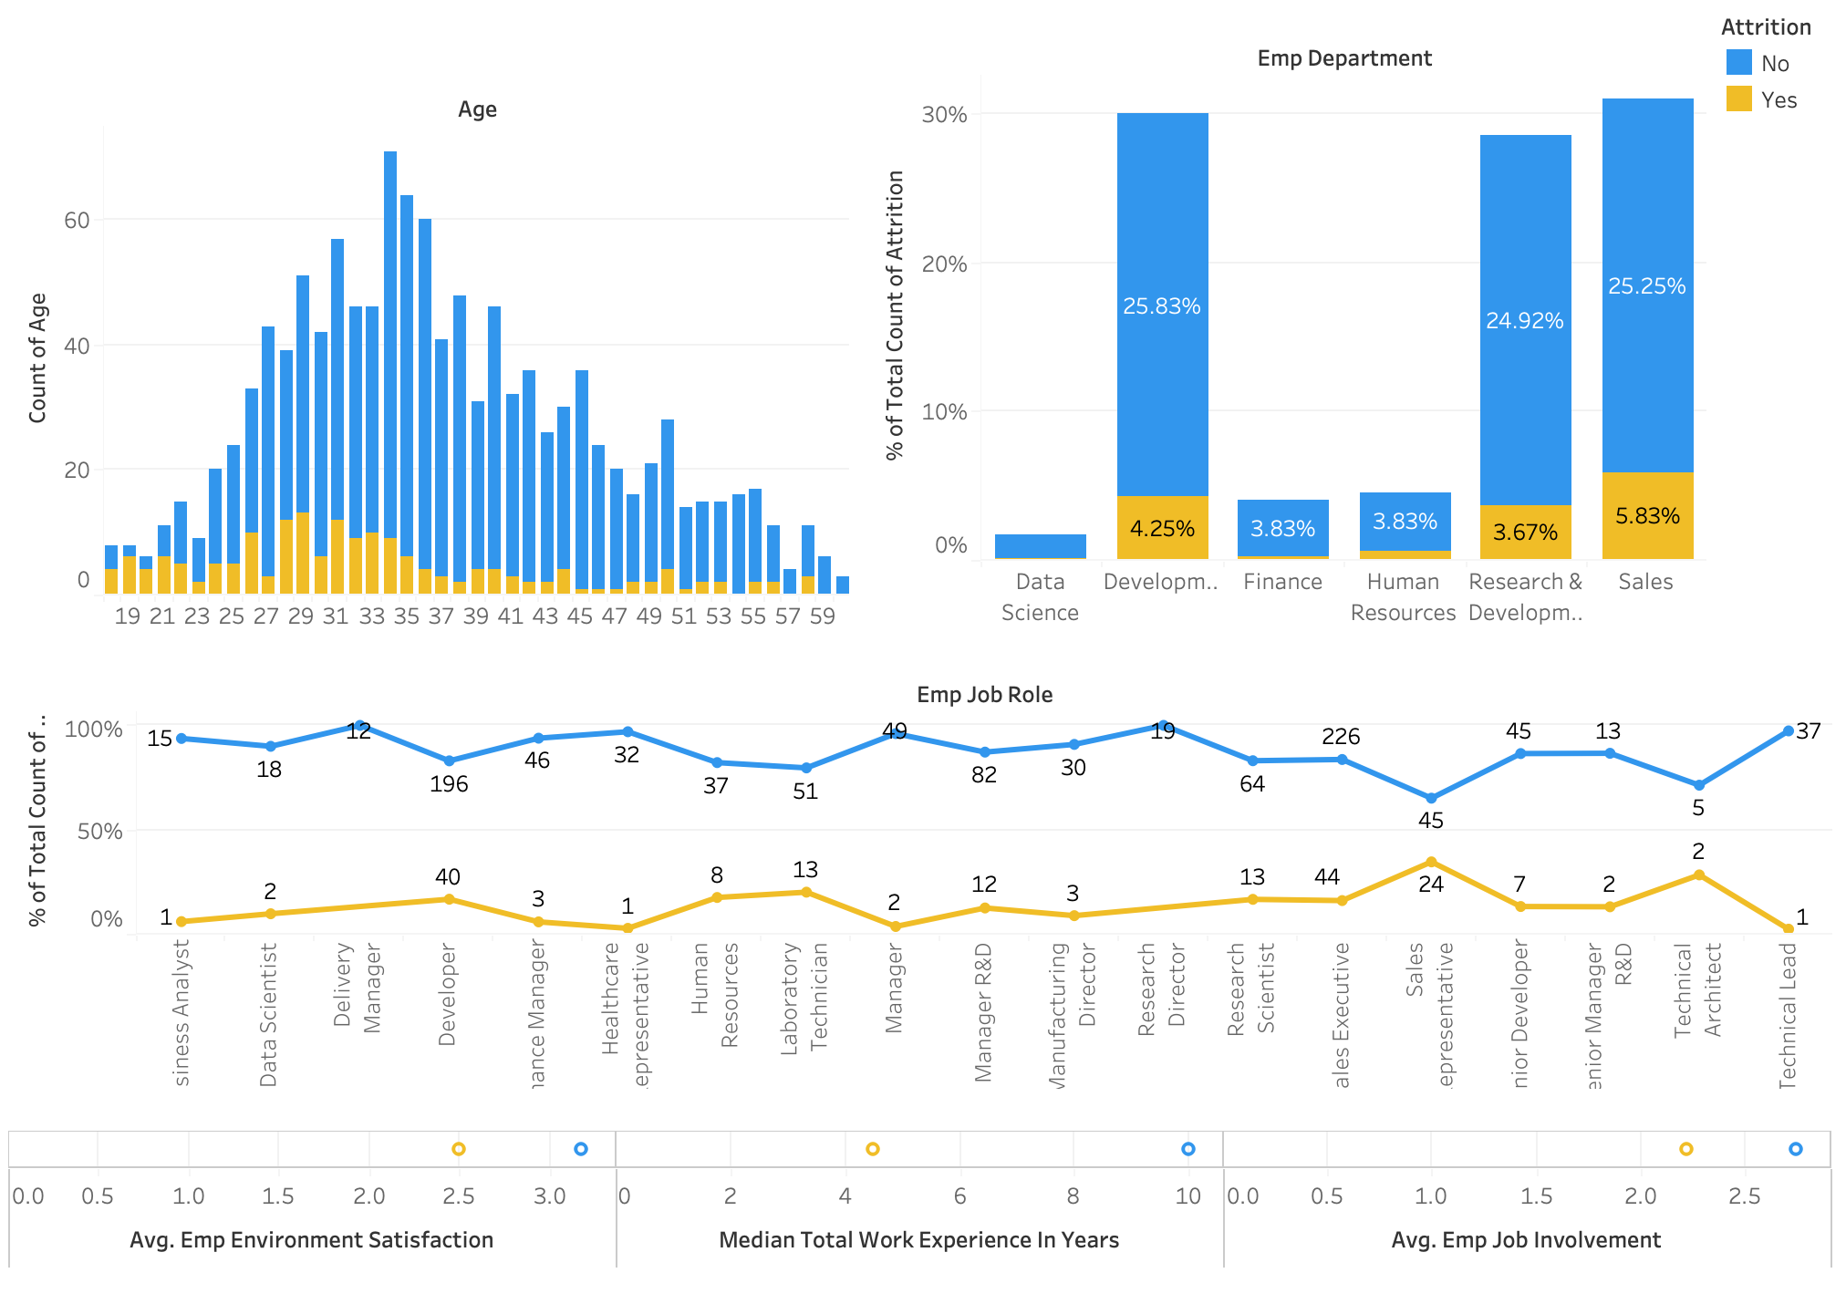
ATTRITION
Most employees that leave the job are between 20-35years
Lesser Environment Satisfaction and Job Involvement leads to attrition
Lesser work experience leads to attrition

Slide 5
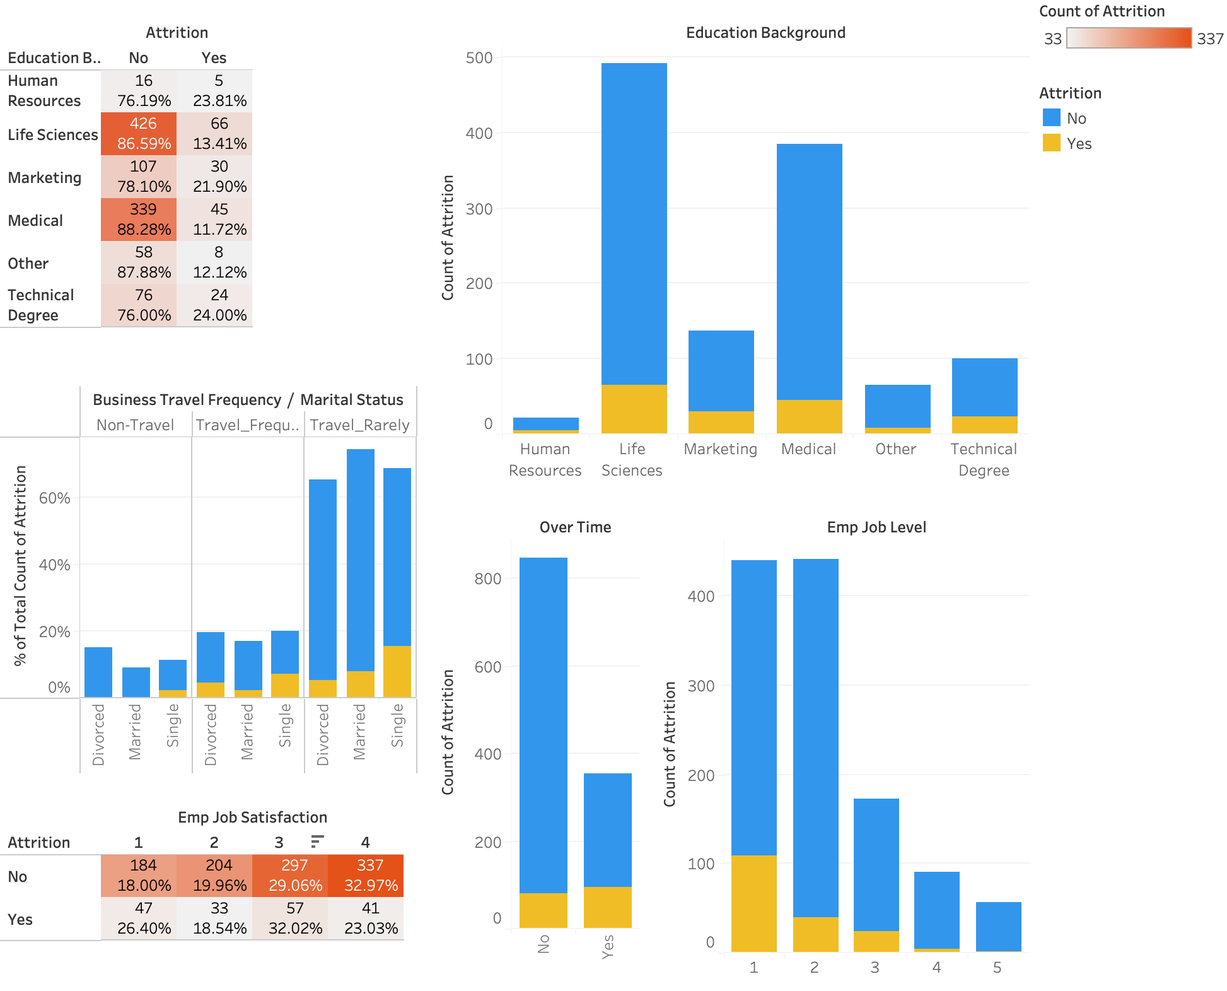
ATTRITION
Most employees have educational background of life sciences and medical. And have least attritions
Single employees who travel rarely tend to leave the company
Overtime employees have more attrition
Employee job level sees more attrition
No clear trend with job satisfaction

Slide 6
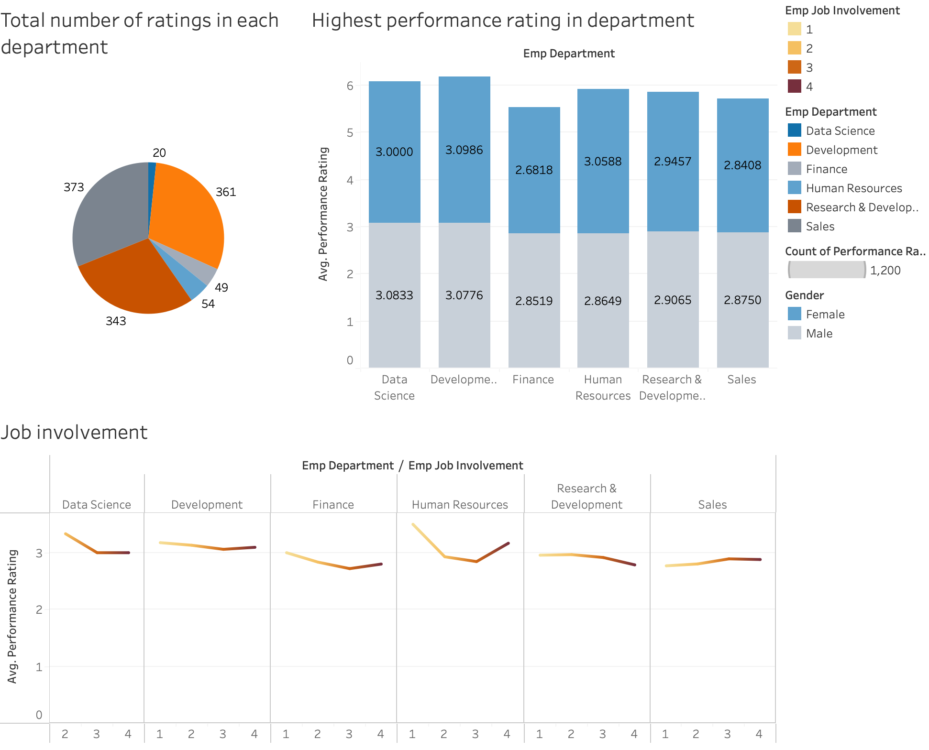
PERFORMANCE
Development department has highest performance rating average
No clear trend of performance rating with gender
A general trend follows that as job involvement rating increases, performance rating decreases.

Slide 7
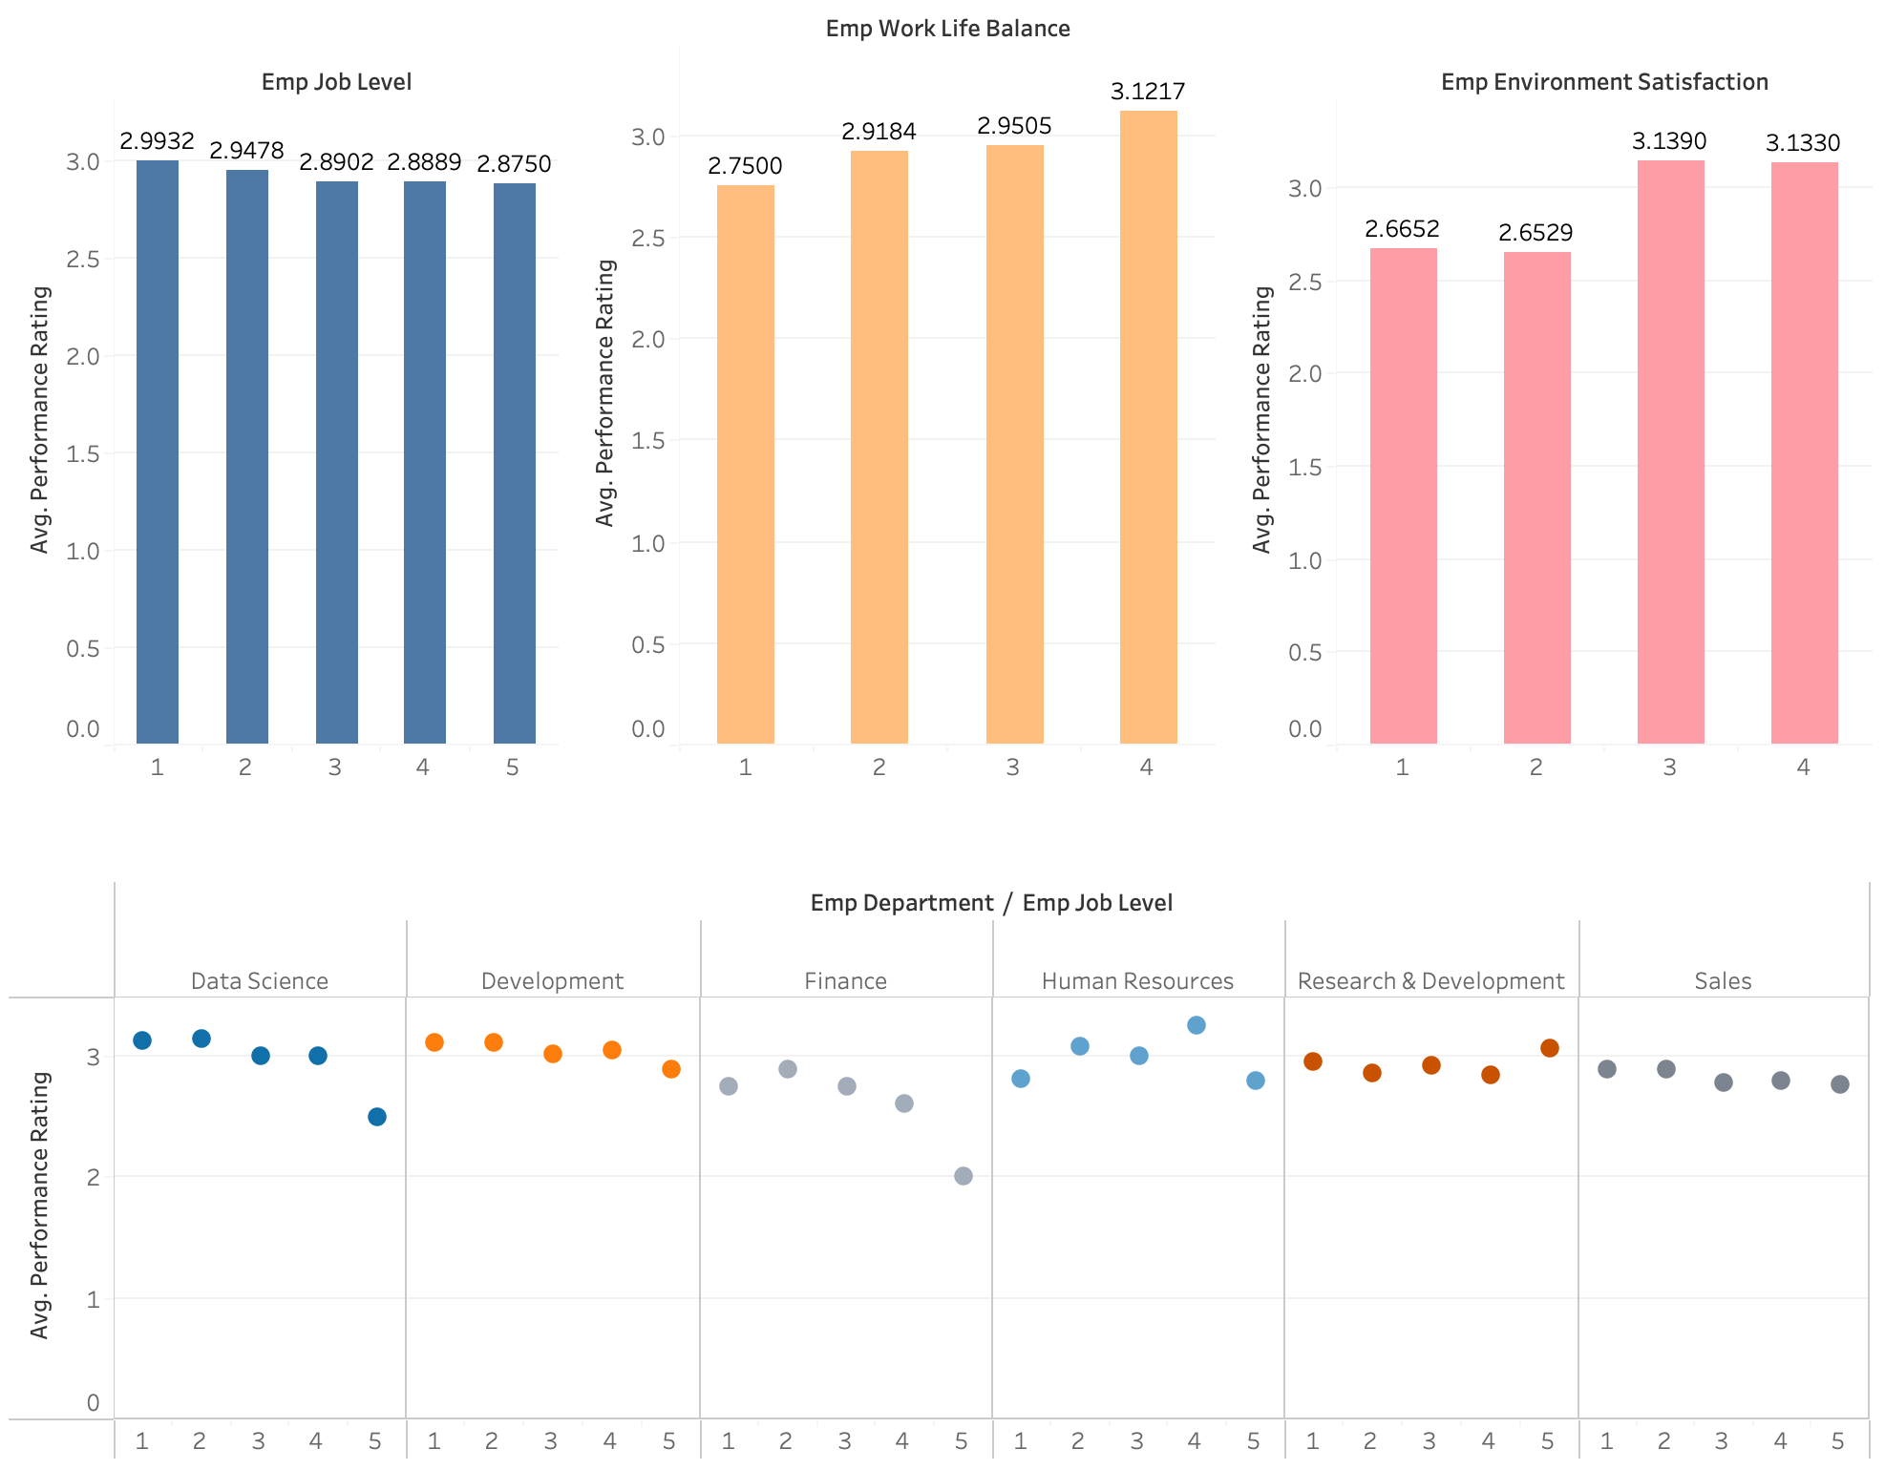
PERFORMANCE
People in higher job levels tend to perform worse than lower levels. Can be due increase in work pressure or lack of motivation.
Better work life balance leads to better performance
Better environment satisfaction leads to better performance

Slide 8
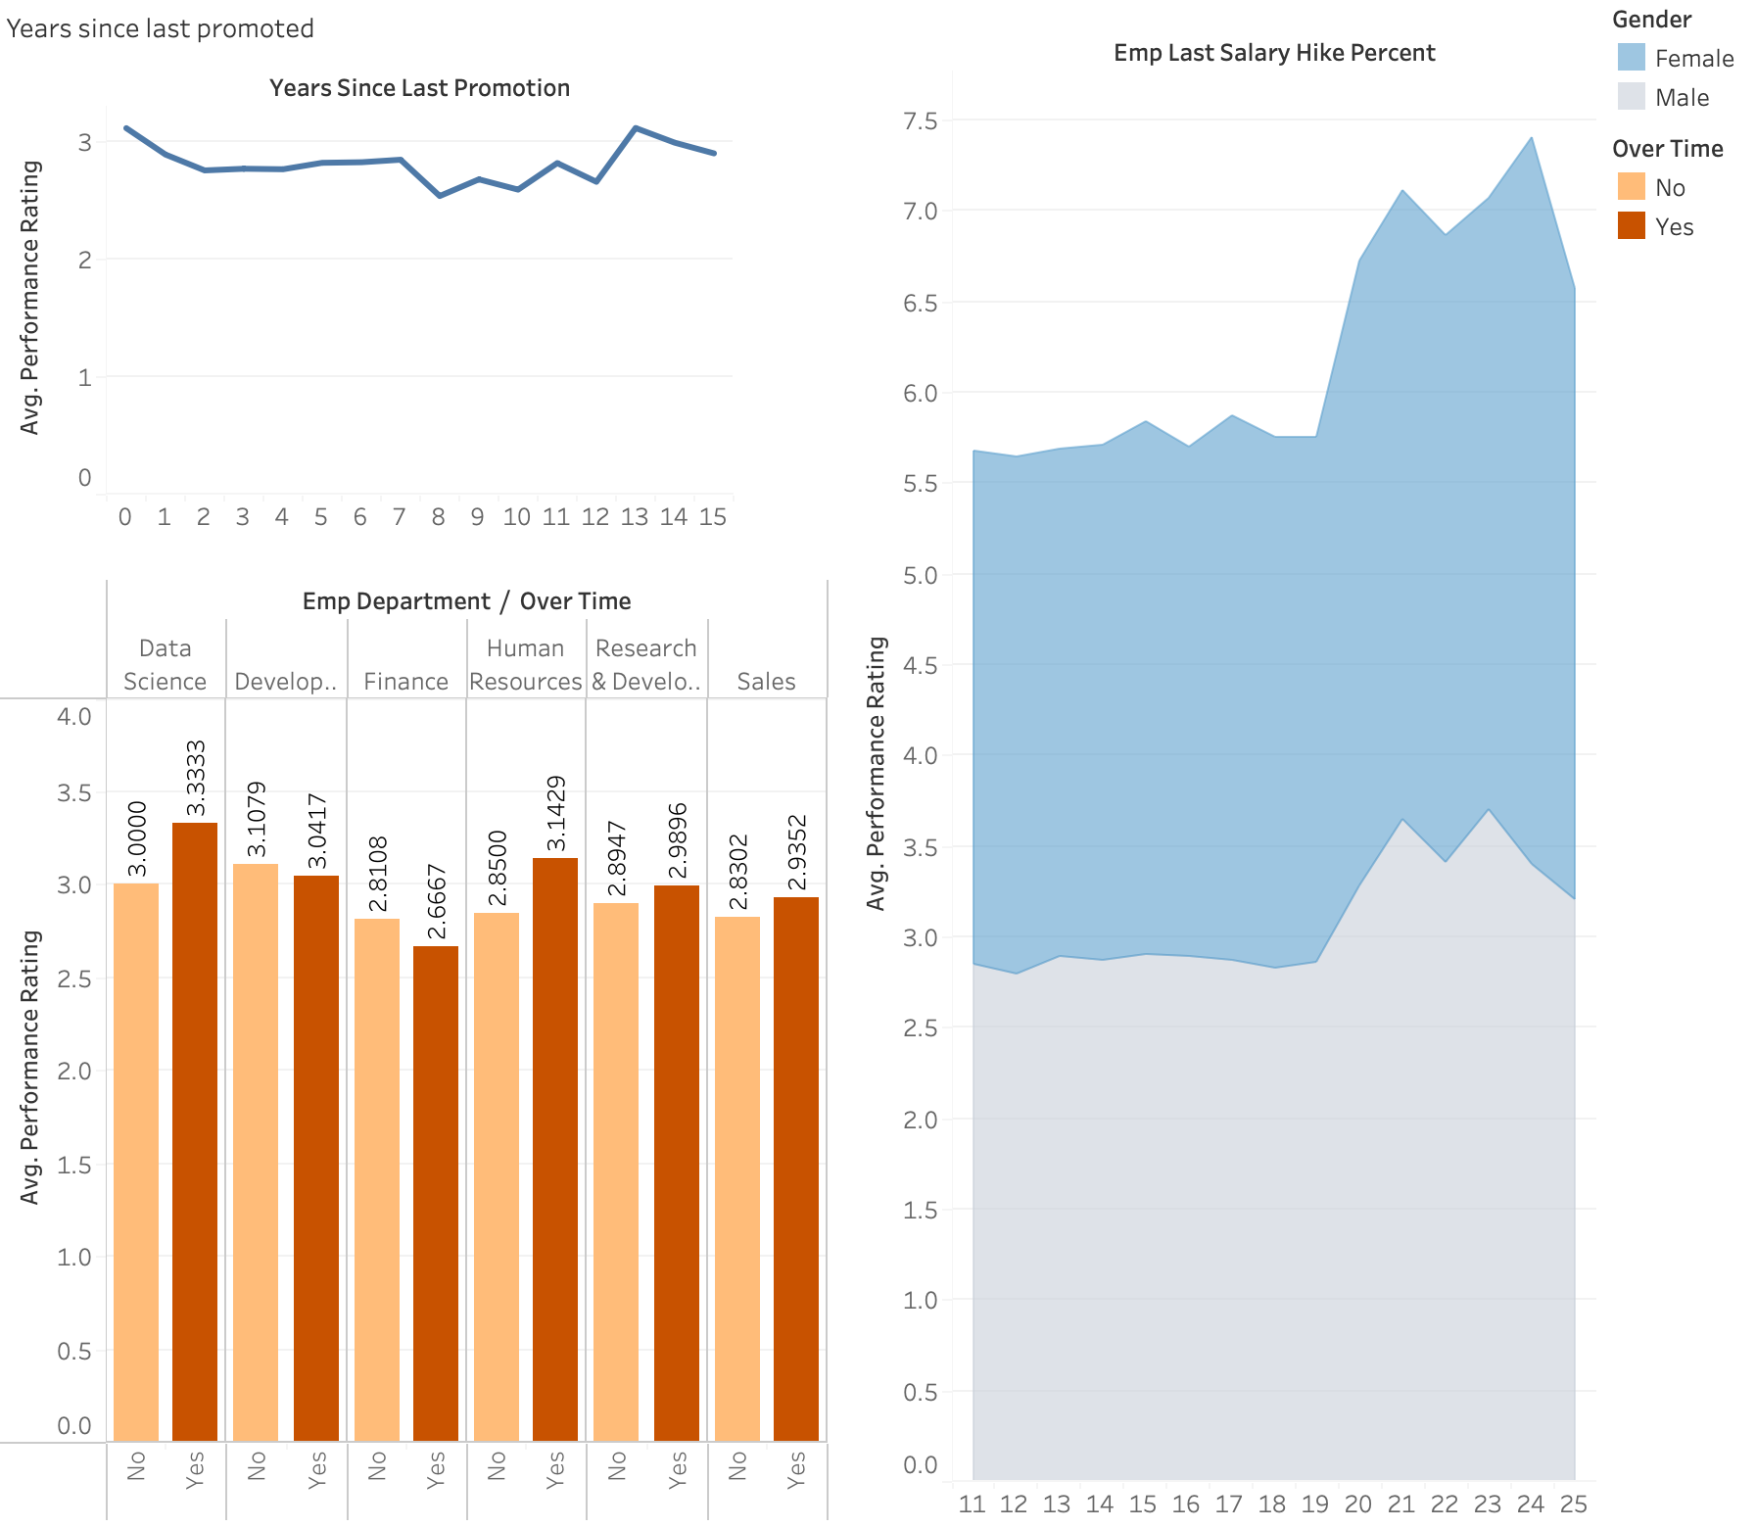
PERFORMANCE
20-25% salary hike leads to better performance. Or better performance leads to better salary hike?
Just promoted have more motivation and hence better performance.
People who haven’t been promoted tend to perform better to expect a promotion.
Over time increases performance rating. Except in Finance probably because finance is more tiresome?

Slide 9
Prediction of performance rating
FEATURE SELECTION
MODEL
SELECTION

Slide 10
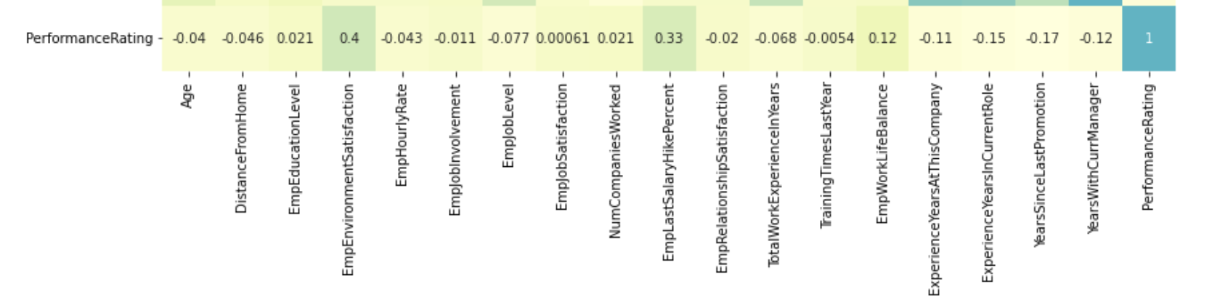
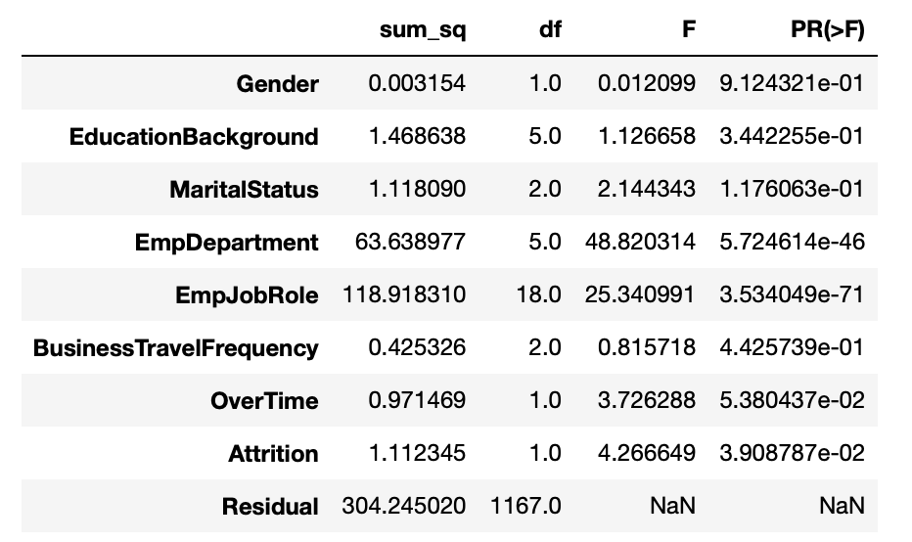
FEATURE SELECTION
NUMERICAL WITH CONTINUOUS FEATURES
NUMERICAL WITH CATEGORICAL FEATURES
Pearson’s correlation
All features with values > |0.1|
ANOVA (Analysis Of Variance)
All features with p-value < 0.05

Slide 11
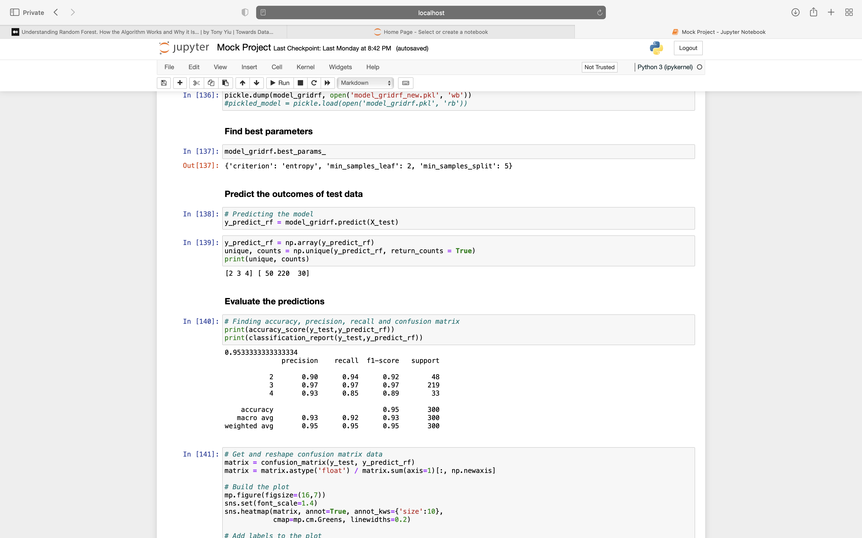
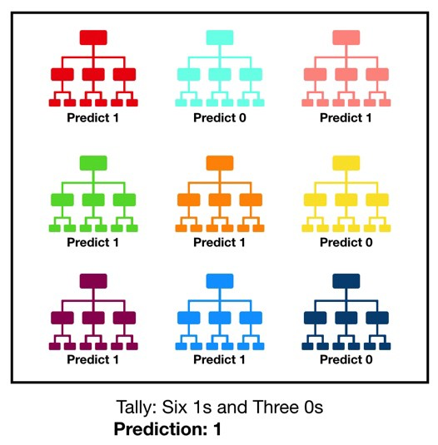
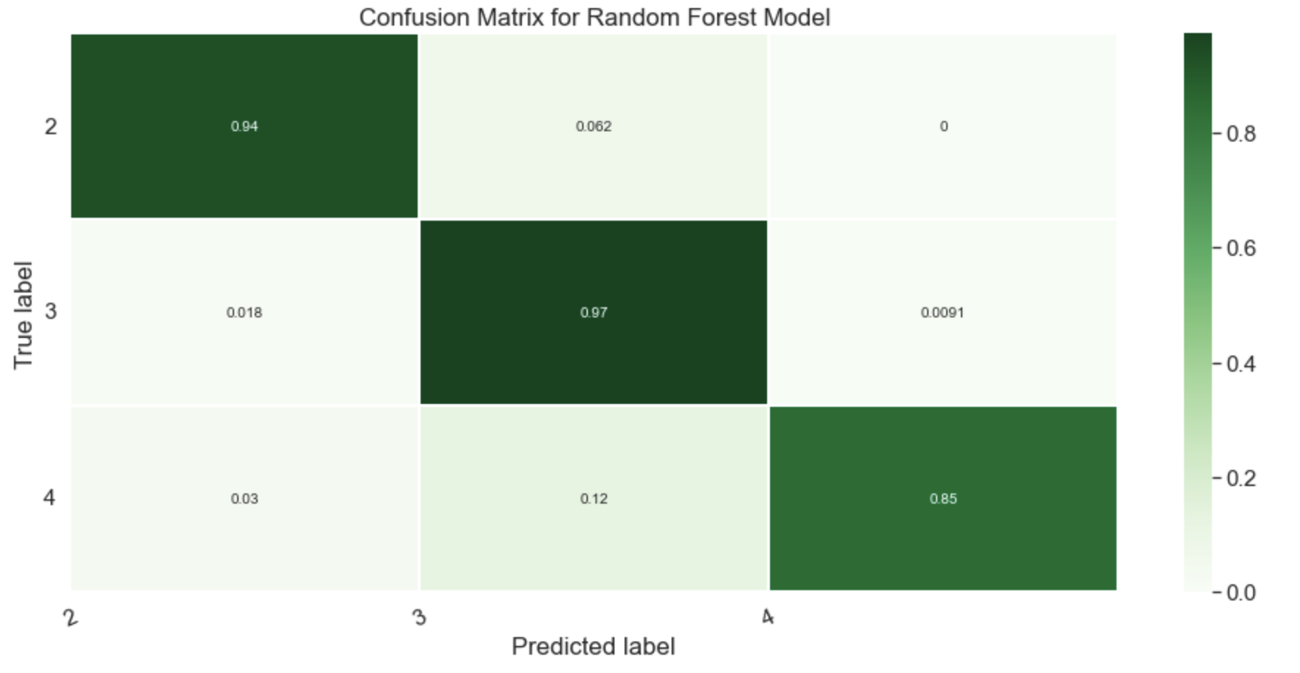
MODEL SELECTION – RANDOM FOREST CLASSIFIER

Slide 12
Integration with web

